Slide 1
Structures

Slide 2

Structures
Structure is a collection of variables that can be of the same or different data types.
Structure is a collection of variables of different data types under a single name
Holds a collection of data of different data types.
The data items in a structure are called the members of the structure.
A user can define its own data types using structures.
Notes:
As we have studied that array is the collection of similar data elements/item. Now if we talk about structures, structures is the collection of variables of same or different datatypes. The elements of structure are known as members.

Slide 3
Structure Declaration
struct structure_name {//members data-type member-1; data-type member-2; data-type member-3; data-type member-4; };
//note: semicolon will be present at the end of structure
Notes:
Now if we talk about structure first we should know how to declare them.
In order to declare structure we have to write the syntax in this way.

Slide 4
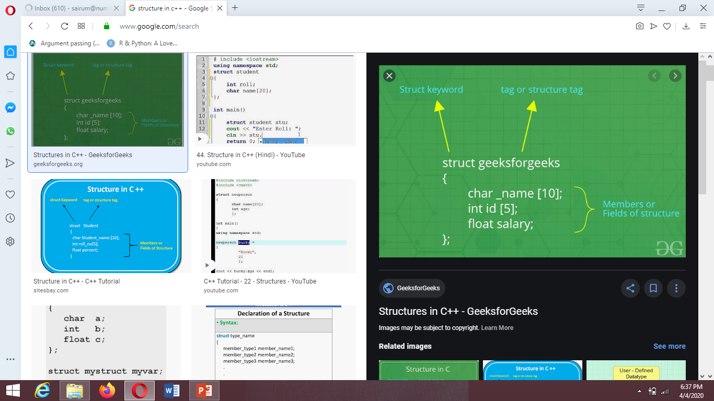

Slide 5
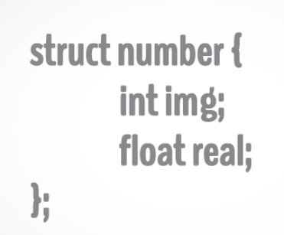

Slide 6
int main
Structure will be declared outside the main
Inside the main there will be an object of structure, this name will be same as the name of structure
It will be written as follows
Structure_name object_name ;
This object is declared to access the members of structure
Method to access the members of structures is:
object_name.member_name;
Dot operator will be used

Slide 7
struct Record
{
int x = 7; //member
};
int main()
{
Record s; //object
cout<<“value is”<<s.x;//object.member
}
Notes:
In this slide you can see a structure named as Record.
It has 1 member. Member is same as any variable
Now inside the main we will create an object of structure. It will be written as structure-name object-name and if you want to access or use the member of a structure you will access it by dot operator i.e. object-name.member. In this example we have created an object named as s and this object will access the member using dot operator.

Slide 8
STRUCTURE CAN HAVE MULTIPLE OBJECTS
struct product
{
int weight=10; //member1
double price=19.36; //member1
} ;
int main()
{
product apple; //object1
product banana, //objects2
product melon; //object3
cout<<apple.weight ;
cout<< banana.weight;
cout<< melon.weight;
}
Notes:
Next thing is that structure can have multiple objects, in this slide there is a structure named as product. With 2 members named as weight and price
inside the main there are 3 objects named apple, banana, melon
In order to access the members of structure dot operator will be used i.e. apple. Weight will fetch the weight of an object apple.
same is the case for all other objects.

Slide 9

Structures
Output
Model Number 6244
Part Number 373
Cost is Rs. 217.5
#include<iostream.h>
#include<conio.h>
struct Part
{
int mn;
int pn;
float cost;
};
void main(void)
{ clrscr();
Part p1;
p1.mn=6244;
p1.pn=373;
p1.cost=217.5;
cout<<"Model Number "<<p1.mn<<endl;
cout<<"Part Number "<<p1.pn<<endl;
cout<<"Cost is Rs. "<<p1.cost<<endl;
getch();
}
Notes:
Part is a structure
Mn pn are members
P1 is an object
P1.mn is the way to access the members of structure

Slide 10
Structures
Defining Structure Variables
A structure variable is defined the same way as a variable of any built-in data type i.e.
int age; // age is a variable of built-in data type Integer
part p1; //p1 is a variable of structure type part

Slide 11
Structures
Accessing Structure Members
The members of a structure variable are accessed by a dot operator, i.e.
p1.mn = 6244;
p1.pn = 373;
Another way to Initialize structure variable
Part p1={6244,373};
Means mn value =6244
pn=373

Slide 12
EXAMPLES

Slide 13
Example 1
struct database
{
int id_number;
int age;
float salary;
};
int main()
{
database employee;
employee.age = 22;
employee.id_number = 1;
employee.salary = 12000.21;
cout<< employee.age<<“\n”<< employee.id_number <<“\n”<< employee.salary;
}

Slide 14
Example 2
Write a program that declares a structure to store roll no, marks , average and grade of a student. The program should define a structure variable, inputs the values and then display these values.

Slide 15
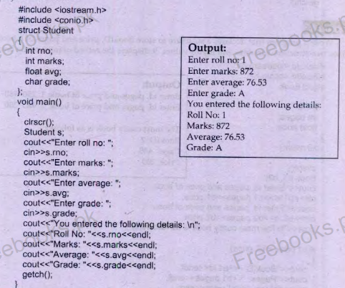

Slide 16
Example 3
Write a program that declares a structure to store day , month and year of the birth. It takes three values and displays date of birth in dd/mm/yy format.

Slide 17
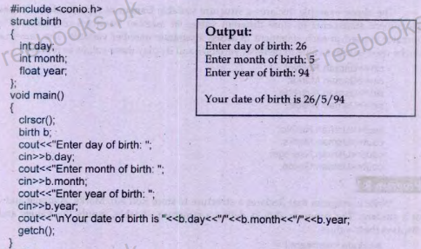

Slide 18
Example 4
Write a program that declares a structure to store bookID, price and page of book. It define two structure variables and inputs the values, it displays the record of most costly book.

Slide 19
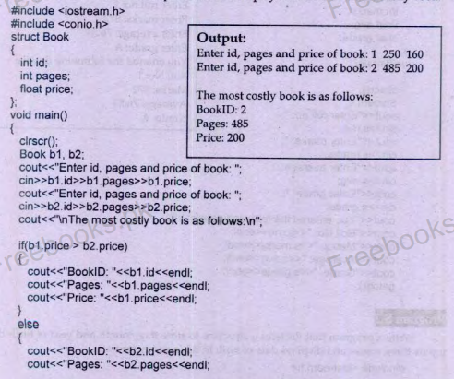
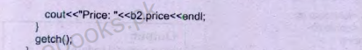

Slide 20
Initializing Structure Variable
struct product
{
int weight; double price;
} ;
int main()
{
product apple={10,20}
}

Slide 21
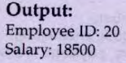
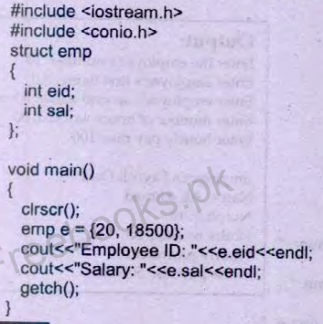
Initializing structure variables

Slide 22
Example 5
Write a structure that stores three parts of phone number i.e. national code, area code and number seperatly.create two variables of a structure . Initiazlize one variable and gets input from the user in other variable and then displays both.

Slide 23
